Slide 1

Fake Product Identification System
Minor Project Based on Industrial Training
Guided By
Mr. Ramakant Ganjeshwar
Assistant Professor
Presented By
Rajkamal Banjare
Dolly Sahu
Sunil Sahu

Slide 2

Introduction
Identification: The Fake Production Identification System leverages blockchain technology to identify counterfeit products.
Verification: It uses a unique digital identity for each product, which can be verified by scanning the product's QR code.-
Transparency: This system provides a transparent and secure platform for tracking and verifying the authenticity of products.

Slide 3
Problem Statement
The problem statement for fake product identification is as follows:-
Counterfeit Products: The global market is flooded with counterfeit products, deceiving consumers into buying unauthentic goods. This not only affects the reputation and financial stability of companies but also poses a serious threat to public safety.-
Need for Reliable Verification: There is a need for a system that allows customers to check the details of the product so that they can decide whether the product is real or fake.
Currently, there is no such system to detect counterfeit products.

Slide 4
Technology Used
HTML/CSS: HTML and CSS are used to structure and style the website. They define the layout and appearance of the web pages.
Bootstrap: Bootstrap, a popular HTML and CSS is used to create responsive and mobile-first web pages. It simplifies web development and ensures consistency across devices.
Blockchain: Blockchain technology forms the backbone of the system, providing a decentralized and secure method of recording transactions.

Slide 5
Progress
Interface Completion: The user interface, designed with HTML, CSS, and Bootstrap, is now fully developed, providing a seamless and interactive experience.
Responsive Design: The use of Bootstrap ensures that the website is mobile-friendly and maintains consistency across different devices.
Ready for Integration: With the completion of the frontend, the system is now ready for integration with the backend, paving the way for full functionality.

Slide 6
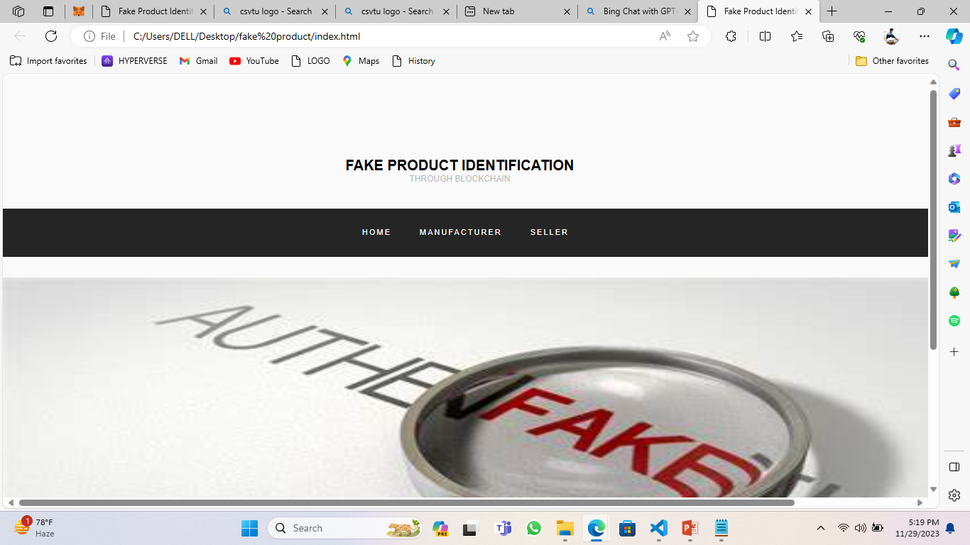
Website Design

Slide 7
Thank You

